Slide 1
Spatial Temporal Rush-Hour Traffic Local Co-location Detection and Spatial Equity
Max Lin, Chih-Ying Liu

Slide 2
Problem Statement
Inputs
Geolocated traffic events
Time-stamped records
Community-level spatial partitions
Demographic and exposure data
Outputs
Spatial temporal local co-location traffic pattern
Identification of spatial equity
Objectives
Find out the traffic pattern and community resource distribution. And provide suggestions to the policy

Slide 3
Significance of Problem
Rush-hour traffic creates concentrated risk in specific locations and time periods.
Some communities may experience higher traffic exposure than others.
Identifying the traffic spatial temporal pattern helps discover the spatial inequality.
Research results support better traffic plan and policy making.

Slide 4
Challenges
Averaging traffic data may hide rush-hour patterns.
Fair comparison across communities requires population normalization.
Detecting high-density traffic zone and calculating population are challenging.

Slide 5
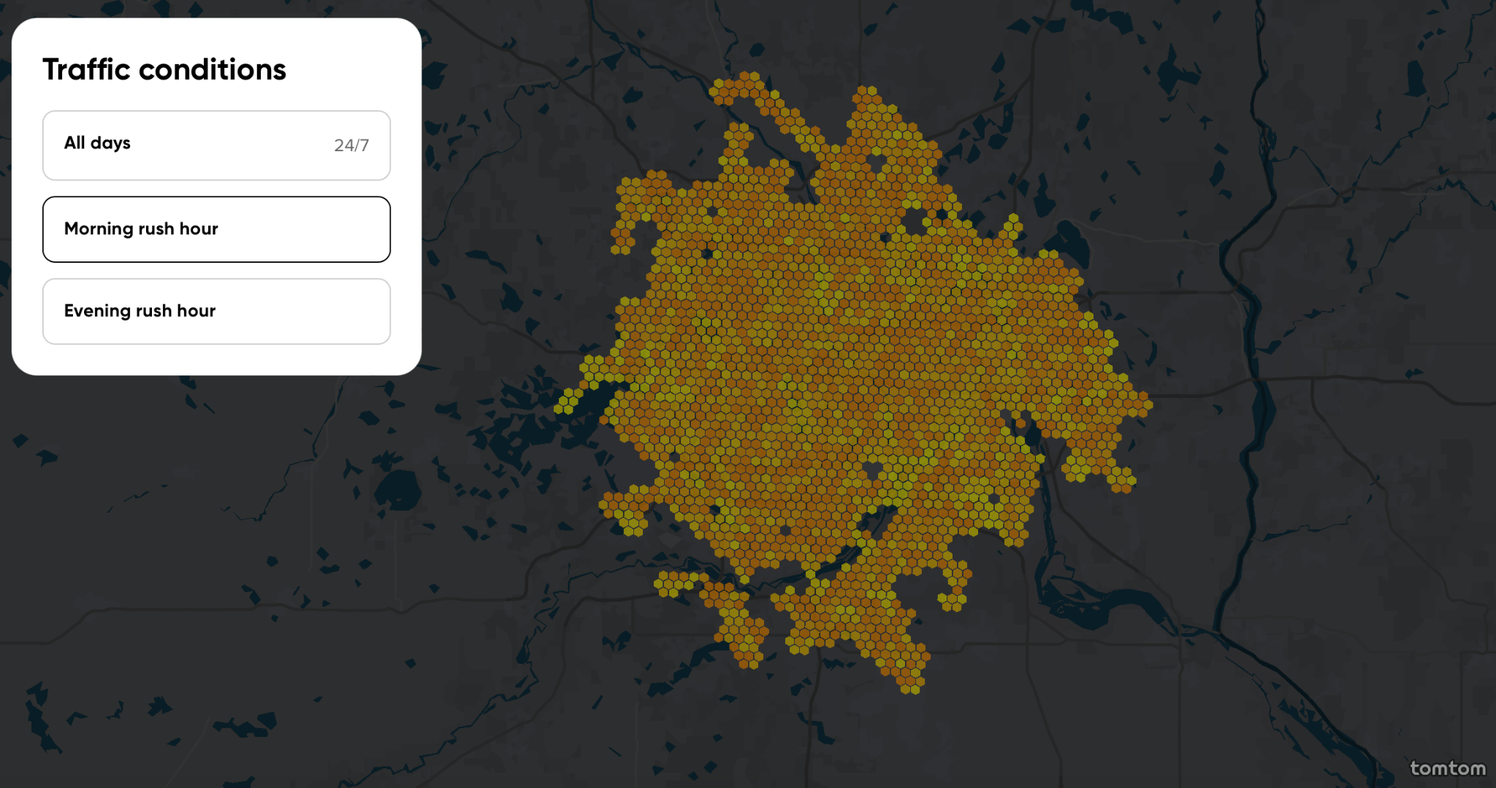
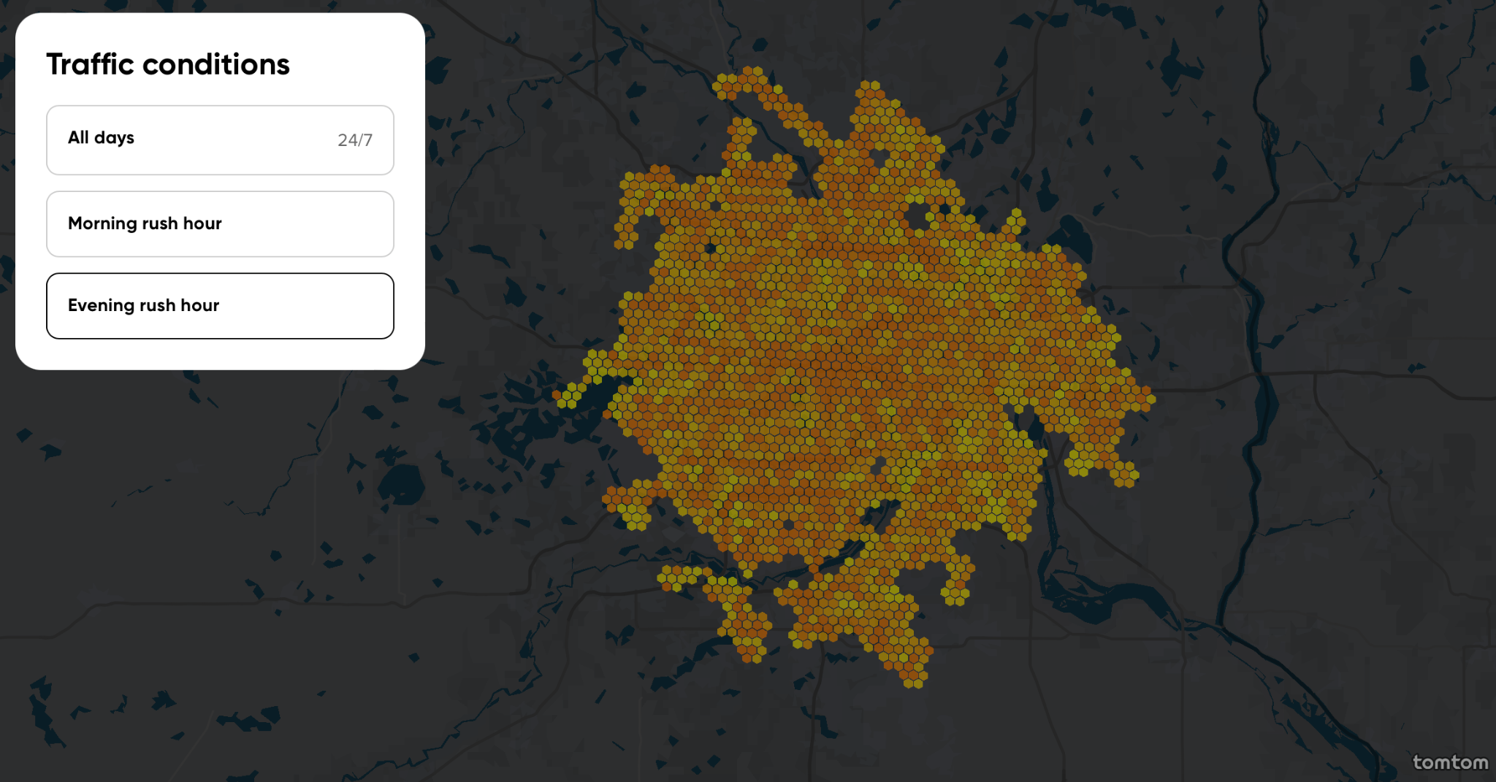
Proposed Approach
Detect the rush-hour traffic risk pattern.
Utilize co-location technique to find out the high-density traffic location.
Morning rush-hour
Tomtom traffic index
Evening rush-hour

Slide 6


Proposed Approach
Participation Rate & Participation Index
Extend participation index by taking time dimension into consideration.
Fix the time on the rush-hour so that the index would not be averaged out.
If considering time

Slide 7
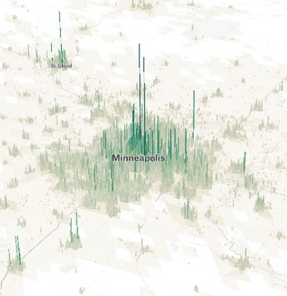
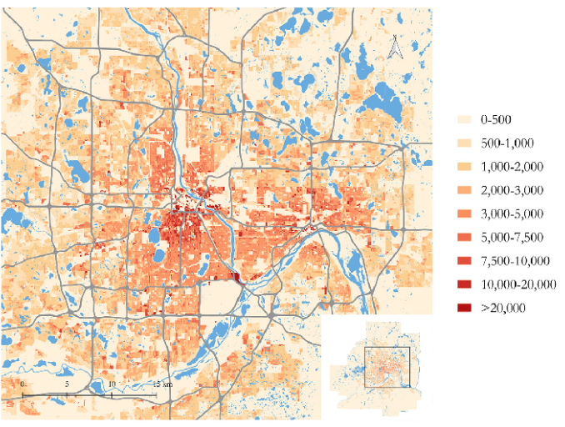

Proposed Approach
Introduce demographic baseline as equity-aware normalization.
Divide each PI by the population ratio for each community as normalization.
Then we call the result as Equity-aware Participation Index(EPI).
This index is used to evaluate the disproportionate traffic risk.
3D view of population density
2D view of population density
*Population density in Minneapolis
*EPI, w are defined by ourselves *Pop: population

Slide 8
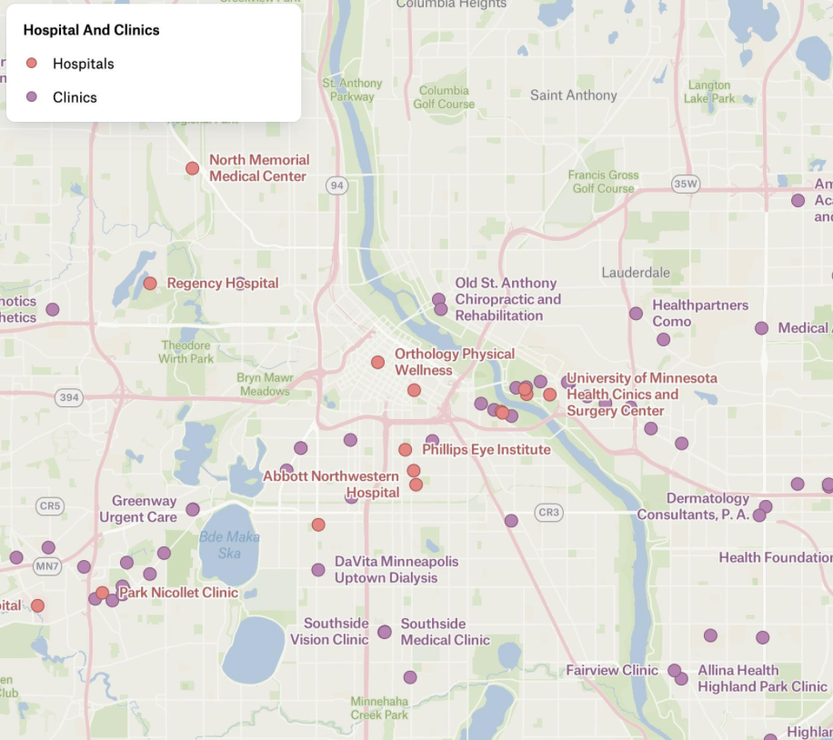
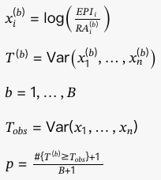
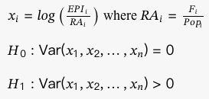
Proposed Approach
Utilize statistical inference and permutation test to examine the spatial equity between communities.
Introduce Resource Availability(RA), representing the specific resource nearby the community.
Visualize the spatial equity.
Public facilities in Minneapolis
Example of public resources: hospitals and clinics
*RA, F are defined by ourselves *F: facilities
Permutation test

Slide 9
Simple Example
 | Community A | Community B | Community C | Community D
Pop | 10000 | 20000 | 15000 | 5000
w | 0.2 | 0.4 | 0.3 | 0.1
PR for accident | 0.3 | 0.2 | 0.2 | 0.4
PR for congestion | 0.2 | 0.2 | 0.1 | 0.2
PI | 0.2 | 0.2 | 0.1 | 0.2
EPI | 1 | 0.5 | 0.33 | 2
F | 5 | 12 | 8 | 1
RA | 0.0005 | 0.0006 | 0.0053 | 0.0002
Equity Indicator(x) | 7.6 | 6.73 | 6.44 | 9.21
T_obs | 1.17
Perms | 999
Count T >= T_bos | 29
p-value | 0.03
Spatial inequality of resources exists

Slide 10
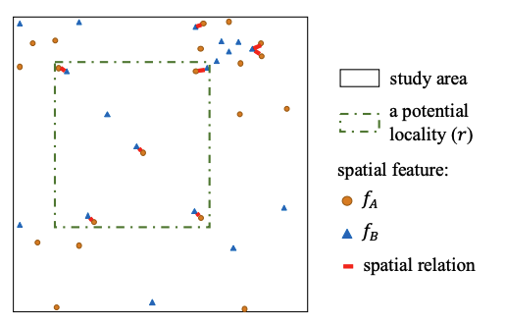
Related Work：Spatial Co-location Pattern Mining
Spatial data mining research uses co-location pattern discovery to detect spatial features that frequently occur together.
Typical techniques include:
Data-unaware spatial partitioning (e.g., QuadTree, grid-based partitioning)
Data-aware clustering methods (detect localities based on clusters of spatial objects)
Application :
Transportation / Traffic Analysis
Urban Planning / Smart Cities
Yan Li, Shashi Shekhar（2018)

Slide 11
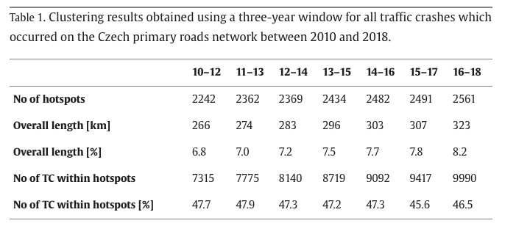
Related Work：Traffic Hotspot Detection
Previous studies analyze traffic crash patterns using spatiotemporal clustering of crash records.
The analysis also identified three hotspot dynamics:
hotspot emergence
hotspot stability
hotspot disappearance
Michal Bíl, Richard Andrášik, Jiří Sedoník（2019)

Slide 12
Limitations
Lack of integrated framework Existing research rarely integrates into a unified framework for traffic equity evaluation.
spatial pattern mining
temporal analysis
demographic normalization
public resource availability
Limitation In Spatial Equity Analysis
Focuses on accessibility to infrastructure, rather than dynamic risk exposure such as traffic accidents.
Doesn’t incorporate spatiotemporal interactions between traffic events and community characteristics.

Slide 13

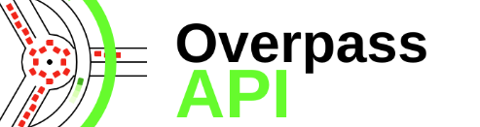
Experimental Methodology
Step1. Data Cleaning
Partitioning local area data to ensure consistent spatial units, taking traffic events, demographic data, and resource locations into the grid structure.
Step2. Detect Spatial-Temporal Co-location Patterns
Extract rush-hour traffic events, identify traffic features that frequently occur together during rush hours, computing Time-aware Participation Index.

Slide 14
Experimental Methodology
Step3. Equity Normalization
To account for population differences across communities, we compute population ratio and Equity-aware Participation Index (EPI).
*EPI, w are defined by ourselves *Pop: population
Step4. Compare Communities
EPI values are compared across communities to identify areas with disproportionate traffic risk exposure.

Slide 15
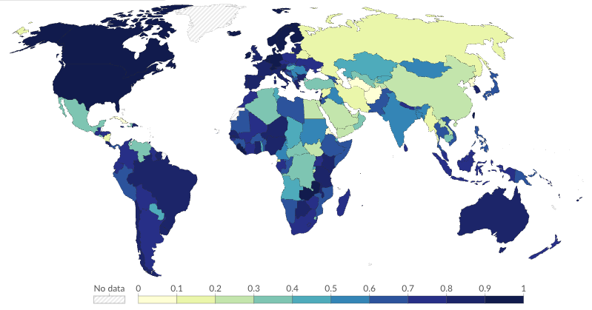
Evaluation Metrics
The proposed framework will be evaluated using:
Participation Index (PI)
Equity-aware Participation Index (EPI)
variance of normalized traffic risk
p-values from permutation tests
These metrics measure both spatial patterns and equity disparities.
Example of Participation Index (PI):
Civil Society Participation Index, 2024
Darker colors represent higher event frequency.

Slide 16
Tasks and Interdependence
Spatial-Temporal Co-location Pattern Detection
extracting rush-hour traffic events, identifying co-occurring spatial features, computing time Participation Index (PI)
Output : Spatial-temporal traffic risk patterns.
Equity-aware Index Computation
Computing population ratio and Equity-aware Participation Index (EPI)
Output : Community-level traffic risk indicators.
Statistical Validation
Determine whether traffic risk distribution across communities is statistically unequal.

Slide 17
Weekly Plan
Week timeline | Tasks
03/16 - 03/20 | data cleaning＋initial code structure planning
03/23 - 03/27 | Analyze rush-hour temporal patterns in the dataset
03/30 - 04/03 | Define fairness metrics and complete the local co-location model
04/06 - 04/10 | Model training
04/13 - 04/17 | Analyze results and adjust the model
04/20 - 04/24 | Final presentations begin

Slide 18
Question?
Email feedback:
liu03674@umn.edu
lin01438@umn.edu

